Slide 1
Telehealth in California: Access, Evidence and Opportunity
Assembly Health
Outcomes Review Oversight Hearing
Marissa Montano, PhD
Senior Policy Officer, State Health Policy Office
August 4, 2026

Slide 2
What is Telehealth?
Medi-Cal uses a broad definition of telehealth: “Telehealth” means the mode of delivering health care services and public health via information and communication technologies to facilitate the diagnosis, consultation, treatment, education, care management and self-management of a patient’s health care. Telehealth facilitates patient self-management and caregiver support for patients and includes synchronous interactions and asynchronous store-and-forward transfers.
For CHCF’s purposes and focus, this is how I propose defining telehealth:
Telehealth
Synchronous or asynchronous
Autonomous Health
Chatbots, artificial intelligence, machine learning
Live
Live, two-way interaction between a patient and a provider using audiovisual telecommunications technology (e.g., video or audio-only)
Store-and-forward
Asynchronous provider to provider transmission of health information through an electronic system. Information used to evaluate the case or render a service outside of a real-time or live interaction (e.g., e-consult)
Remote patient monitoring (RPM)
Personal health and medical data collection from an individual in one location via electronic communication, which is transmitted to a provider in a different location for use in care and related support.
Mobile Health*
Health care and public health practice and education supported by mobile communication devices such as cell phones, tablet computers, and PDAs.
*Could include the execution of other modalities (e.g. video, RPM), in which case it would be in scope.

Slide 3
Telehealth in California: A Policy Snapshot
California set the stage pre-pandemic for progress during and beyond the pandemic
Pre-COVID
Before 2020
During COVID
2020–2022
After COVID
2022 onward
1996 · SB 1665 Telemedicine Development Act sets payment and care standards; Medi-Cal coverage begins.
2011 · AB 415 Telehealth Advancement Act modernizes the definition, ends the phone/email ban, and opens telehealth to all Medi-Cal providers.
2019 · AB 744 / 1264 / 1494 Commercial payment parity, remote prescribing, and Medi-Cal telehealth during emergencies.
2020 · Emergency waivers DHCS disaster-relief flexibilities expand audio-only, waive location limits, and pay video and phone visits.
2021 · AB 133 Extends telehealth flexibilities and convenes the Telehealth Advisory Workgroup to shape post-emergency policy.
2022 · SB 184/ AB 32 Makes Medi-Cal coverage of video, audio-only, and store-and-forward telehealth permanent, with guardrails.
2024 · Evaluation Era DHCS releases its first Biennial Telehealth Utilization Report tracking access, quality, and cost.
2025 · AB 688 Telehealth for All Act requires ongoing Medi-Cal telehealth reporting to guide future policy.
Source: CCHP, Telehealth in California: Legislative History (1996–2022); CA DHCS.

Slide 4
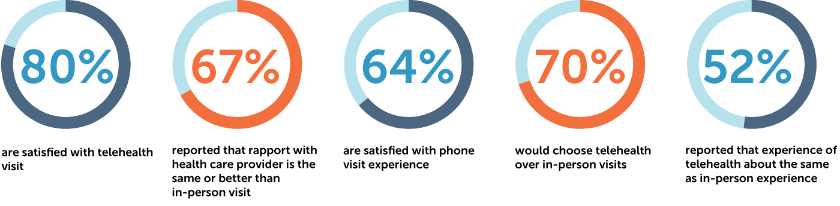
Patient Perspectives on Telehealth
Key findings:
Although interviewees report different levels of comfort, satisfaction, and future interest in telehealth, many commonalities in experiences and future preferences for telehealth emerged from this research. Findings are presented below:
  Telehealth increases access to health care for many Californians with low incomes.
  Interviewees’ experiences with video visits reveal some trade-offs.
  Telehealth helps patients build stronger relationships with their providers.
  Telehealth visits with language-concordant providers are more effective.
  Californians with low incomes want telehealth to play an integral role in their future care.
  Patients want to choose or be involved in decisions about the modality of their visits.
Patients who use telehealth wish to continue:
Source: CHCF, Telehealth Experiences and Preferences Among Californians with Low Incomes (2023); Journal of Patient Experience, Telehealth Use and Satisfaction Among U.S. Households: Results of a National Survey (2021); UCLA, Telehealth and the Future of Health Care Access in Californian (2023)

Slide 5
We need that appointment, but
we hesitate because we can’t ask for time off. . . . [With telehealth], we can work around our lunch or break schedule . . . and they’re more likely to say yes than [to] requesting a whole day.
I don’t have a vehicle, so
telehealth allows me to utilize
[specialist] care that I just would not have
access to otherwise. . . . Given the nature of my disabilities, I don’t always remember my
appointments or have a general ability to
get myself mobile enough to get to them. So
having providers who are aware of that, who
can then contact me and still maintain the
Appointments, is incredibly helpful.
A 44-year-old Latina/x
in Los Angeles
A 30-year-old nonbinary person in Northern California
Source: CHCF, Telehealth Experiences and Preferences Among Californians with Low Incomes (2023)

Slide 6
Evidence For Telehealth's Effectiveness
Evidence is strongest when modality, condition, and patient need are matched
Synchronous video
Convincing evidence for behavioral health and chronic condition management; promising evidence for other applications.
Audio-only
Promising evidence for behavioral health; also helps address access when video is not feasible.
eConsults
Clear evidence for increasing access to and timeliness of specialty care, and for reducing cost of care.
Evidence gaps: While telehealth has become an established component of health care delivery in California, important evidence gaps persist, particularly regarding system-level costs, the effectiveness of hybrid care models, and the extent to which telehealth equitably serves and improves outcomes for different California populations.
Source: CHCF, Telehealth’s Evolution in California: Progress, Challenges, and Opportunities (2025).

Slide 7
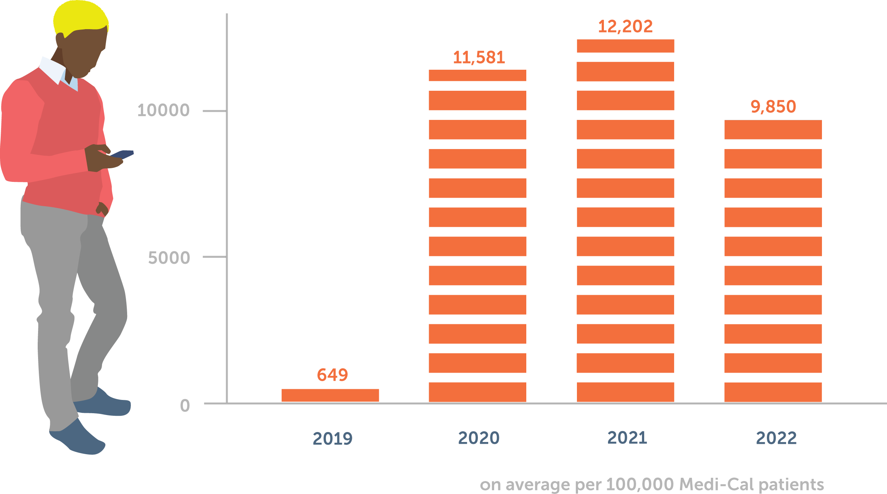
What We've Learned: Telehealth Use Remains Elevated
Utilization remains higher than before COVID-19
  Telehealth use rose rapidly during the pandemic and has remained elevated relative to the pre-pandemic baseline.
  Telehealth utilization in Medi-Cal remained higher in 2022 than pre-pandemic. Data beyond 2022 is not available.
  In Medicare, telehealth use remained higher in 2025 than before the public health emergency.
Sources: CHCF, Telehealth’s Evolution in California (2025); CMS, Medicare Telehealth Trends Report (May 2026)

Slide 8
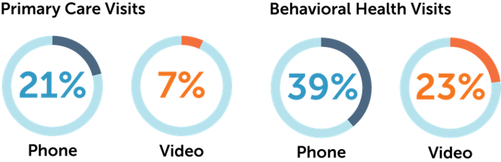
Audio-only Is Important for Access to Care
Audio-only is common and important
  Audio-only remains especially common in safety-net and behavioral health care and is a key access point for patients facing digital barriers.
Sources: CHCF, Telehealth’s Evolution in California (2025); Telehealth Use and Experiences Among California Adults (CHCF, 2023); RAND/JAMA California FQHC telehealth study (2023).

Slide 9
Telehealth Helps Patients Access the Care They Need
Patient experience is a strength
  Californians with low incomes report telehealth can reduce transportation and time-away-from-work barriers, and patients want the option to continue. Today- this is especially important for immigrant communities as fear mounts in response to federal policy shifts and hostility toward immigrants in the U.S.
Disparities persist
  Medi-Cal enrollees, older adults, and speakers of languages other than English use telehealth less than comparison groups.
Sources: CHCF, Telehealth’s Evolution in California (2025); Telehealth Use and Experiences Among California Adults (CHCF, 2023); RAND/JAMA California FQHC telehealth study (2023).

Slide 10
Key Takeaways
Telehealth is not a replacement for in-person care—it is an important tool that expands access, increases flexibility, and helps Californians receive the care they want and need.
The evidence indicates that telehealth is an effective mode of care for many services and populations.
Telehealth reduces barriers that prevent patients from obtaining timely care and helps maintain access to services patients want and need.
Preserving access to telehealth—including audio-only options—will remain important to supporting equitable access to care across California.

Slide 11
Thank You!
Contact Us:
Marissa Montano: mmontano@chcf.org
Diana Camacho: dcamacho@chcf.org

