Slide 1
BHCIP Rounds 3-5
Launch Ready
Children and Youth
Crisis and Behavioral Health Continuum

Slide 2
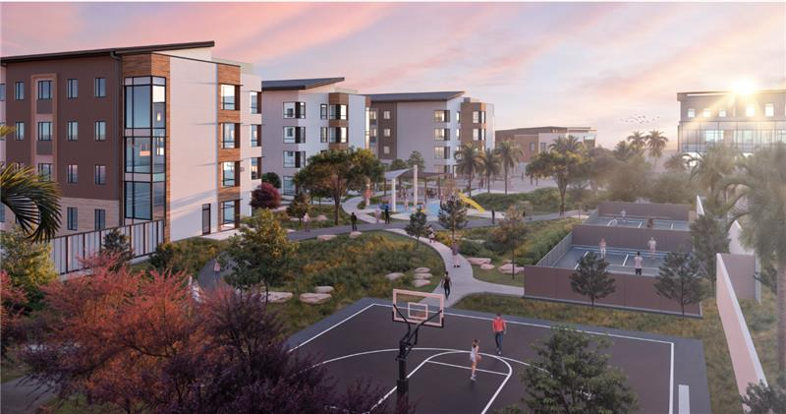
Riverside University Health System, BH Campus (County Entity)
Notes:
Groundbreaking on June 12, 2024
Projected construction completion by December 2026
BHCIP Round 3
Social Rehabilitation Facility - 16 beds
Mental Health Rehabilitation Center - 50 beds
Adult Residential Treatment Facility for SUD - 40 beds
Office-Based Opioid Treatment - 288 treatment slots and projected to serve 9,600 individuals annually
Crisis Stabilization Unit - 12 treatment slots and projected to serve 2,190 individuals annually
Sobering Center - 15 treatment slots and projected to serve 2,670 individuals annually
BHCIP Round 4
Children's Crisis Residential Program - 16 beds
Short-Term Residential Therapeutic Program - 3 beds​
Community Mental Health Clinic - 152 treatment slots and projected to serve 3,000 individuals annually
Crisis Stabilization Unit -12 treatment slots and projected to serve 2,300 individuals annually

Slide 3
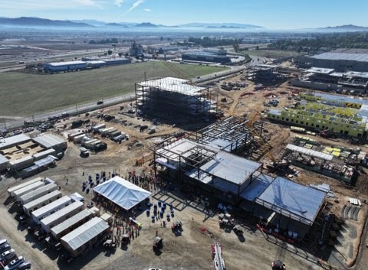
Riverside University Health System, BH Campus (County Entity)
Notes:
Groundbreaking on June 12, 2024
Projected construction completion by December 2026
BHCIP Round 3
Social Rehabilitation Facility - 16 beds
Mental Health Rehabilitation Center - 50 beds
Adult Residential Treatment Facility for SUD - 40 beds
Office-Based Opioid Treatment - 288 treatment slots and projected to serve 9,600 individuals annually
Crisis Stabilization Unit - 12 treatment slots and projected to serve 2,190 individuals annually
Sobering Center - 15 treatment slots and projected to serve 2,670 individuals annually
BHCIP Round 4
Children's Crisis Residential Program - 16 beds
Short-Term Residential Therapeutic Program - 3 beds​
Community Mental Health Clinic - 152 treatment slots and projected to serve 3,000 individuals annually
Crisis Stabilization Unit -12 treatment slots and projected to serve 2,300 individuals annually

Slide 4
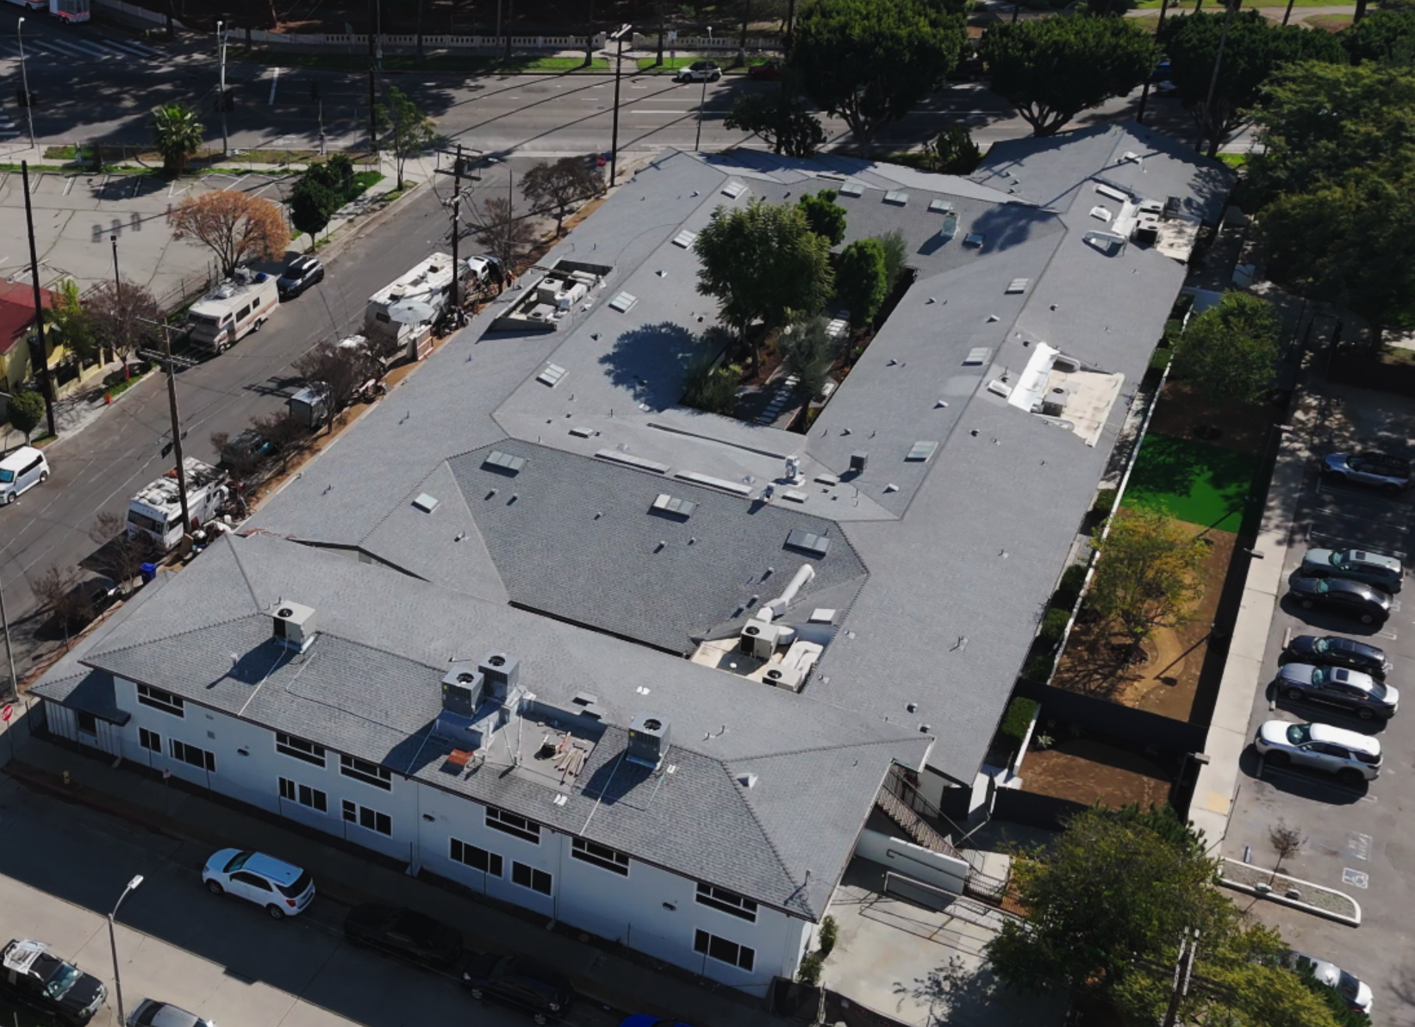
CRI-Help, Inc. Los Angeles County (Nonprofit Organization)
Opened February 2025
Notes:
Continuation of CRI-Help project. (Arial view and facility photo)
Open and providing services as of February 7, 2025
BHCIP Round 5
Adult Residential SUD Treatment Facility - 78 beds
Intensive Outpatient Treatment - 43 treatment slots and projected to serve 500 individuals annually
Sobering Center - 8 treatment slots and projected to serve 2,190 individuals annually

Slide 5
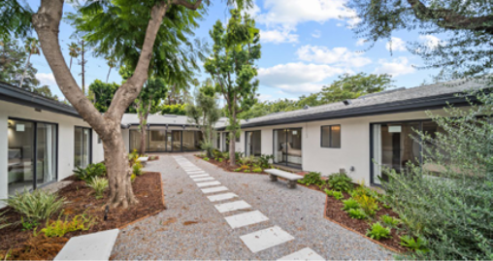
CRI-Help, Inc. Los Angeles County (Nonprofit Organization)
Opened February 2025
Notes:
Continuation of CRI-Help project. (Arial view and facility photo)
Open and providing services as of February 7, 2025
BHCIP Round 5
Adult Residential SUD Treatment Facility - 78 beds
Intensive Outpatient Treatment - 43 treatment slots and projected to serve 500 individuals annually
Sobering Center - 8 treatment slots and projected to serve 2,190 individuals annually

Slide 6
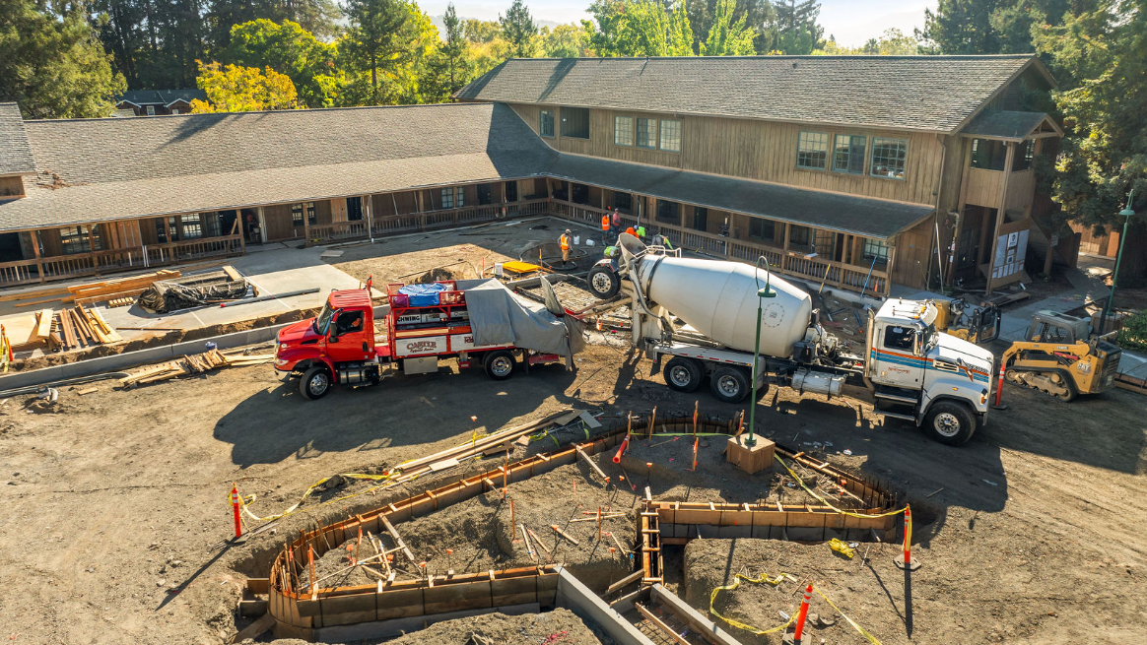
Mentis Napa County (Nonprofit Organization)
Opening for services on March 4, 2025
Notes:
Opening for services on March 4, 2025
BHCIP Round 4
Community Mental Health Clinic – 9 treatment slots and projected to serve 250 individuals annually
Community Wellness/Youth Prevention Center – 112 treatment slots and projected to serve 1,500 individuals annually

Slide 7
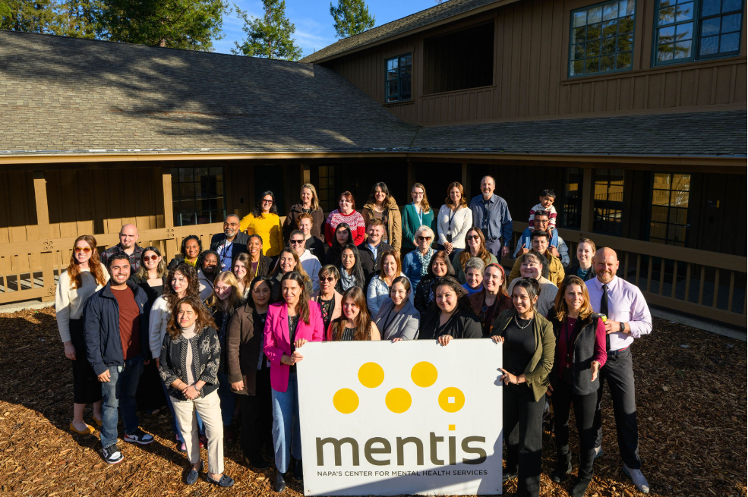
Mentis Napa County (Nonprofit Organization)
Opening for services on March 4, 2025
Notes:
Opening for services on March 4, 2025
BHCIP Round 4
Community Mental Health Clinic – 9 treatment slots and projected to serve 250 individuals annually
Community Wellness/Youth Prevention Center – 112 treatment slots and projected to serve 1,500 individuals annually

